Slide 1



PIZZA
SALES REPORT
20
25
presented by
Pranav Jain

Slide 2



20
24
INTRODUCTION
Hi, My name is Pranav Jain. My project focuses on applying SQL (Structured Query Language) to analyze a dataset of pizza sales transactions. The primary objective was to understand how database queries can be used to extract meaningful insights from raw sales data. Pizza businesses generate large amounts of transactional data every day, such as customer orders, sales amounts, item preferences, and time-based trends. By writing optimized SQL queries, I was able to answer real-world business questions and uncover valuable patterns.
02
presented by
Pranav Jain

Slide 3


20
25
EXECUTIVE SUMMARY
This project applies SQL queries to analyze pizza sales data and extract valuable business insights. By leveraging data aggregation, filtering, and joins, the analysis identifies best-selling pizzas, peak sales periods, and revenue trends. The results demonstrate how SQL can support data-driven decision-making, helping businesses improve operations, optimize inventory, and enhance customer satisfaction..
03

Slide 4

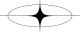
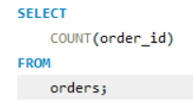
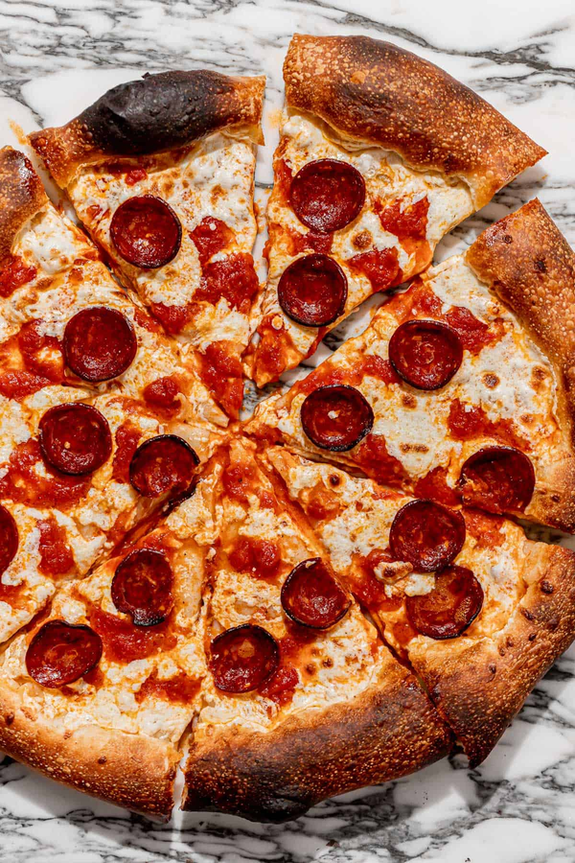
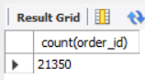
1.RETRIEVE THE TOTAL NUMBER OF ORDERS PLACED.
20
25
04

Slide 5
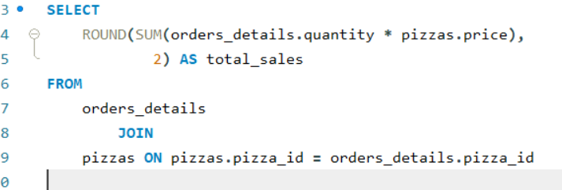
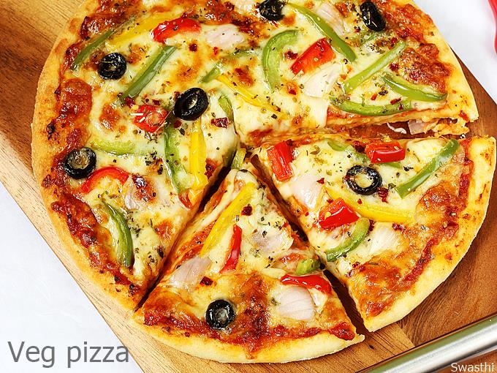
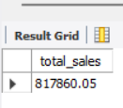
2.CALCULATE THE TOTAL REVENUE GENERATED FROM PIZZA SALES.
20
25
05

Slide 6
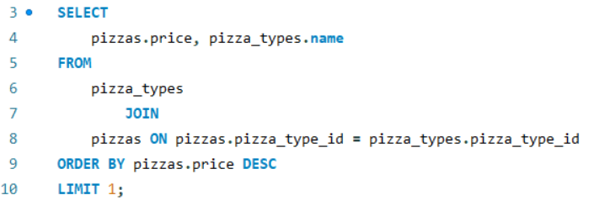
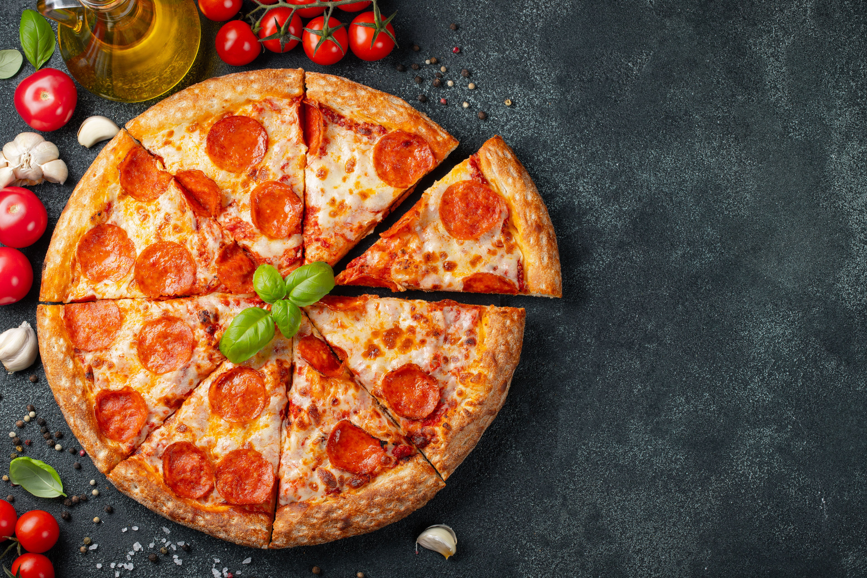
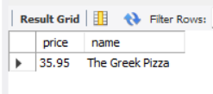
IDENTIFY THE HIGHEST-PRICED PIZZA.
20
25
06

Slide 7
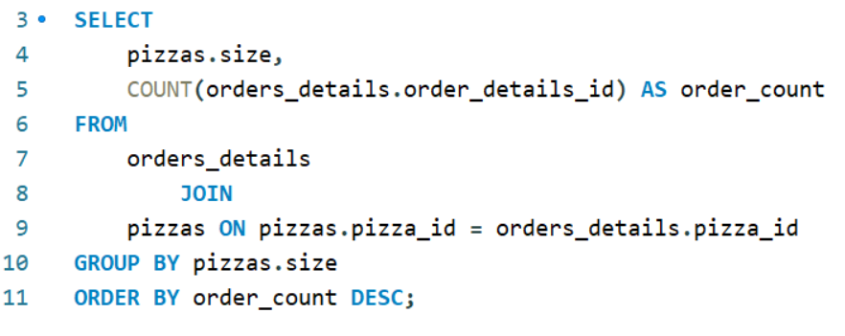
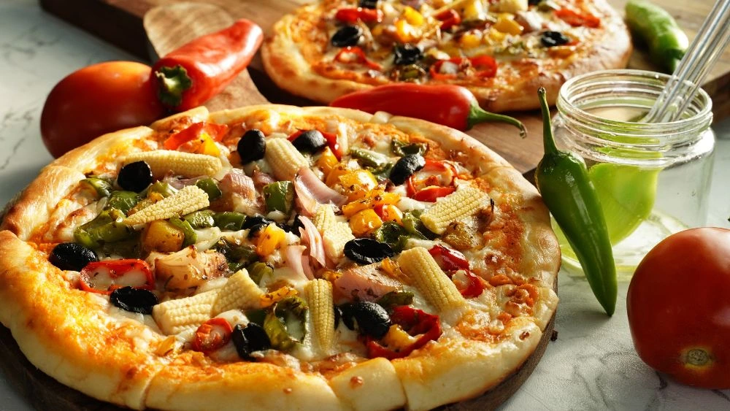
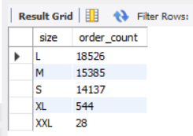
IDENTIFY THE MOST COMMON PIZZA SIZE ORDERED.
20
25
07

Slide 8
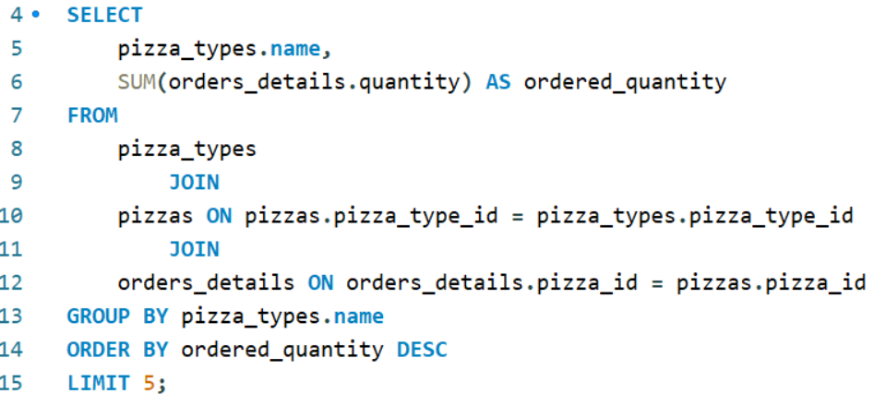
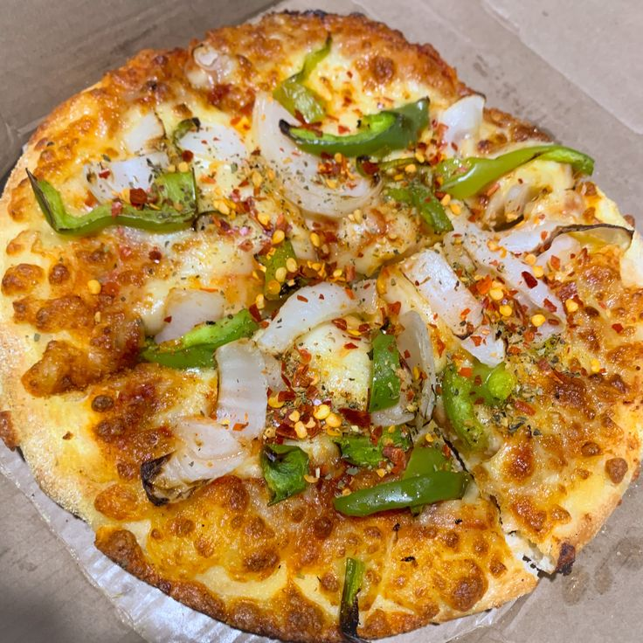
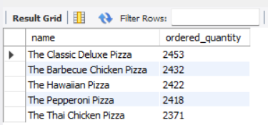
LIST THE TOP 5 MOST ORDERED PIZZA
types along with their quantities.
20
25
08

Slide 9
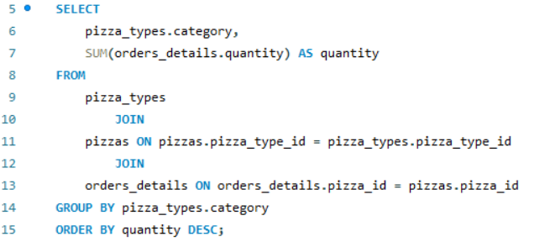
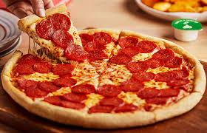
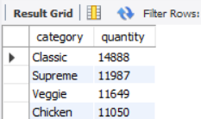
JOIN THE NECESSARY TABLES TO
find the total quantity of each pizza category ordered.
20
25
09

Slide 10
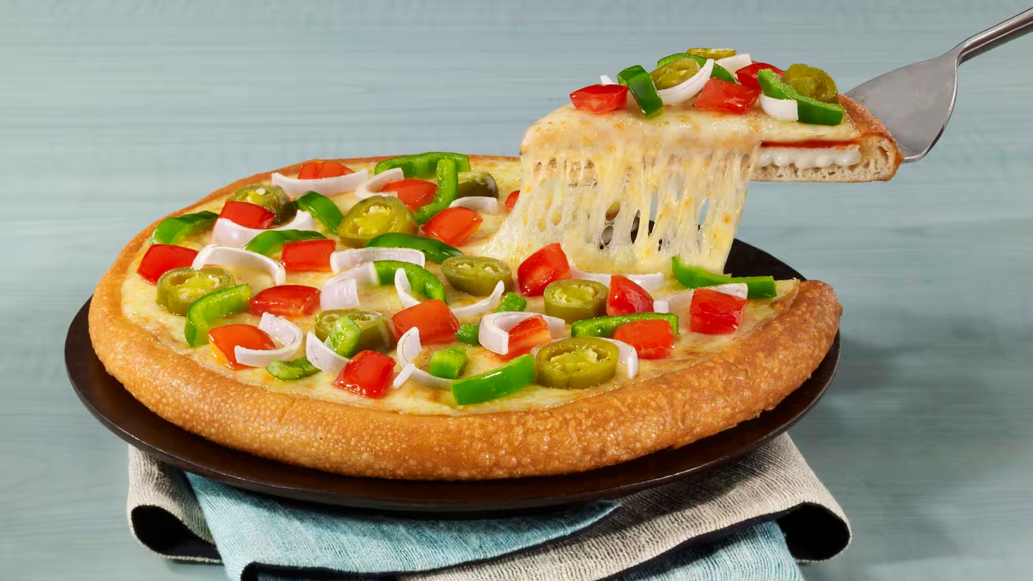
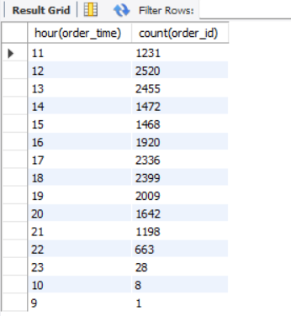
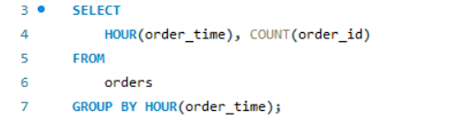
DETERMINE THE DISTRIBUTION OF ORDERS BY HOUR OF THE DAY.
20
25
10

Slide 11
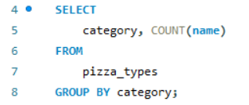
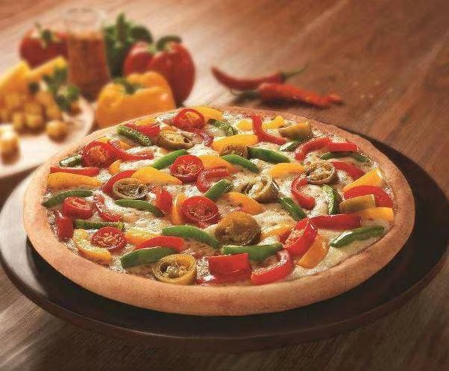
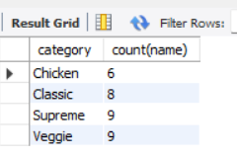
JOIN RELEVANT TABLES TO
find the category-wise distribution of pizzas.
20
25
11

Slide 12
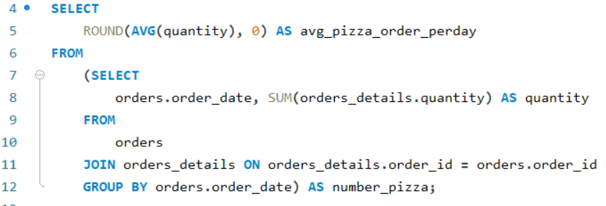
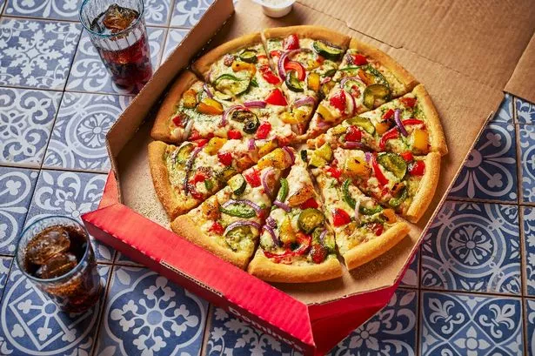
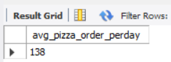
GROUP THE ORDERS BY DATE AND CALCULATE THE AVERAGE
number of pizzas ordered per day.
20
25
12

Slide 13
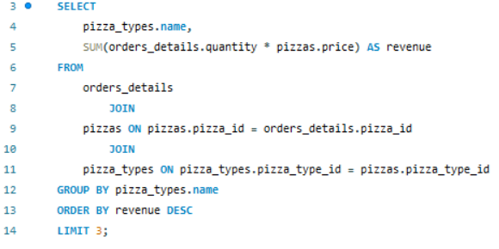
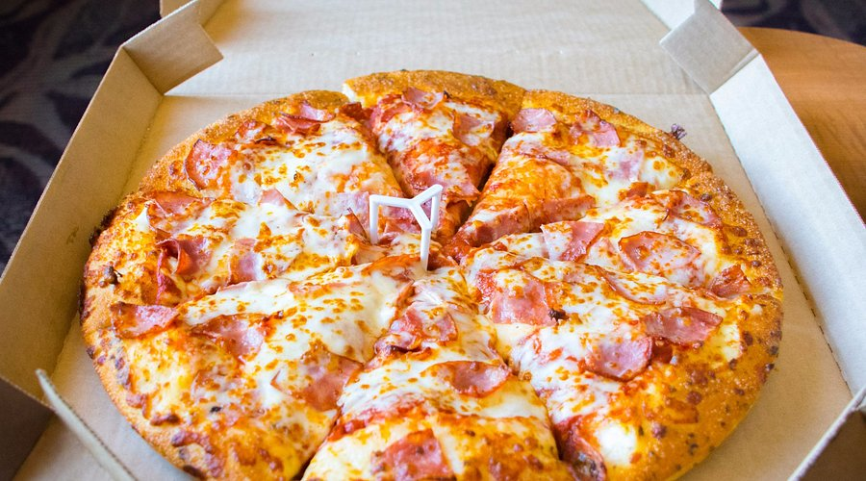
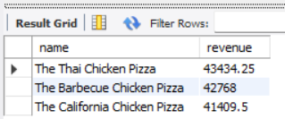
DETERMINE THE TOP 3 MOST ORDERED PIZZA TYPES BASED ON REVENUE.
20
25
13

Slide 14
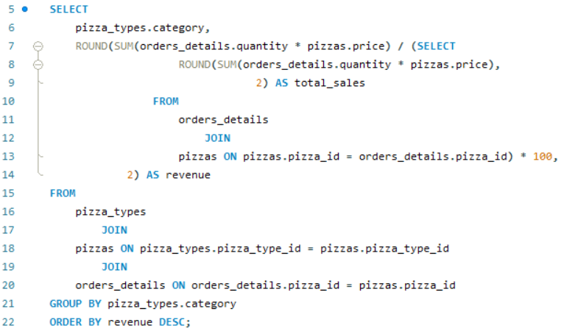
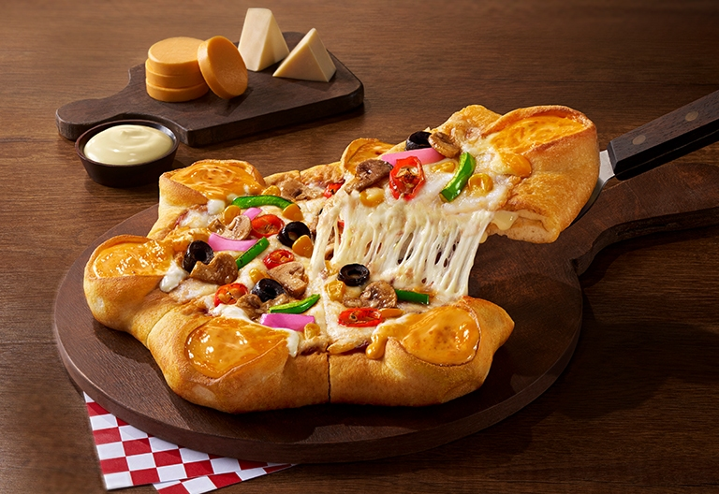
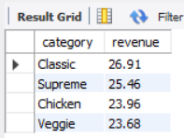
DETERMINE THE TOP 3 MOST ORDERED PIZZA TYPES BASED ON REVENUE.
20
25
14

Slide 15
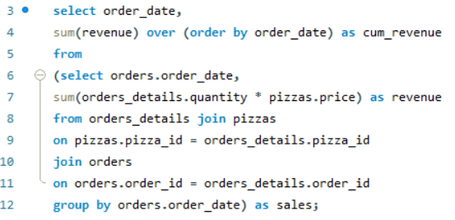
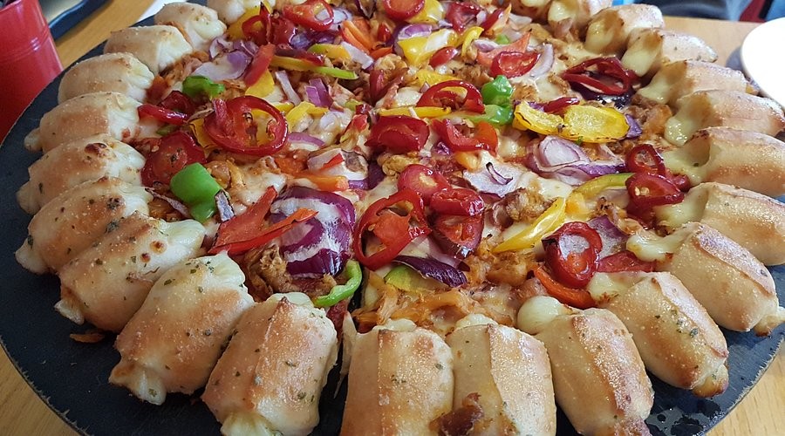
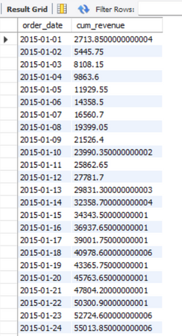
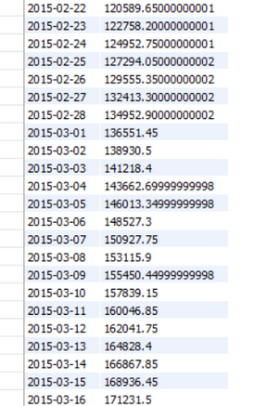
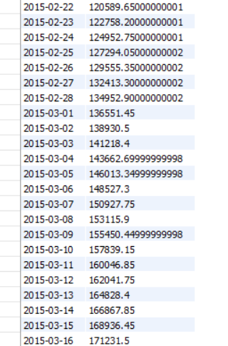
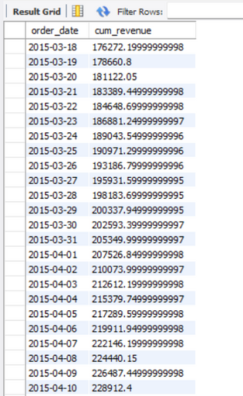
ANALYZE THE CUMULATIVE REVENUE GENERATED OVER TIME
20
25
15

Slide 16
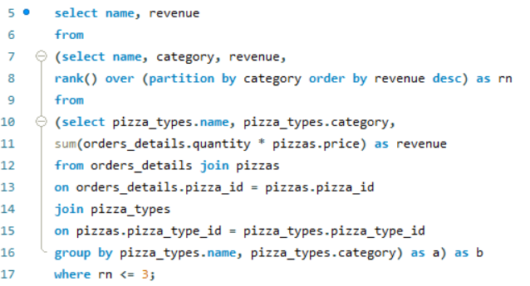
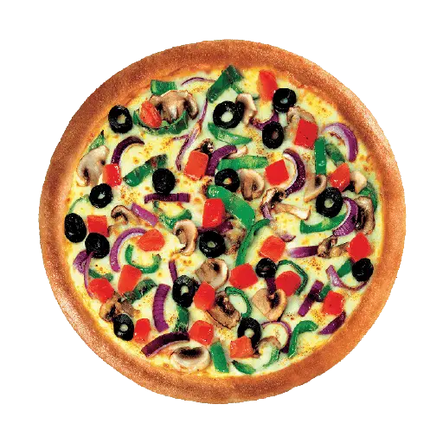
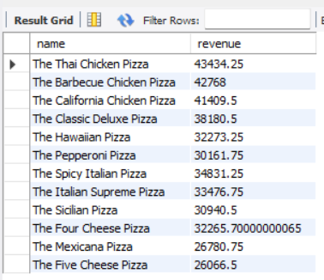
DETERMINE THE TOP 3 MOST ORDERED PIZZA types based on revenue
for each pizza category.
20
25
16

Slide 17

www.linkedin.com/in/pranav-jain-s2003
pranavjain9090@gmail.com
https:;//github.com/Pranav-j-ain
THANK YOU!
Thank you for your attention to our Pizza sales report presentation.Through this project, I gained practical exposure to working with relational databases and applying SQL for business decision-making. These insights could help a pizza outlet or chain improve its operations—for example, by optimizing inventory, offering targeted promotions, or adjusting staffing levels during busy hours.

